Slide 1
A click chemistry amplified nanopore assay for ultrasensitive quantification of HIV-1 p24 antigen in clinical samples
March 30, 2023
Chunlin Min
Wei, X., Wang, X., Zhang, Z. et al. A click chemistry amplified nanopore assay for ultrasensitive quantification of HIV-1 p24 antigen in clinical samples. Nat Commun 13, 6852 (2022). https://doi.org/10.1038/s41467-022-34273-x

Slide 2
Outline
Background
HIV
Click Chemistry
Nanopore
Paper
Assay workflow & overview
Characterization profiles of nanopore system
Opinions

Slide 3
Background

Slide 4
Human Immunodeficiency Virus (HIV)
HIV is a virus that attacks the body’s immune system. There is no cure, but treatments with antiretroviral therapy (ART) can stop further progression of HIV
HIV can be transmitted via bodily fluids
progression: Acute HIV -> chronic HIV -> AIDS
20% of new HIV infections are due to transmission from unaware infected individuals
Circulating RNA and antigen p24 are long recognized as significant biomarkers for HIV-1
Earlier studies suggest antigen p24 is a stronger predictor of progression to acquire AIDS than was RNA. However, proteins cannot be amplified like nucleic acid, which makes it challenging to achieve good sensitivity for p24 detection

Slide 5
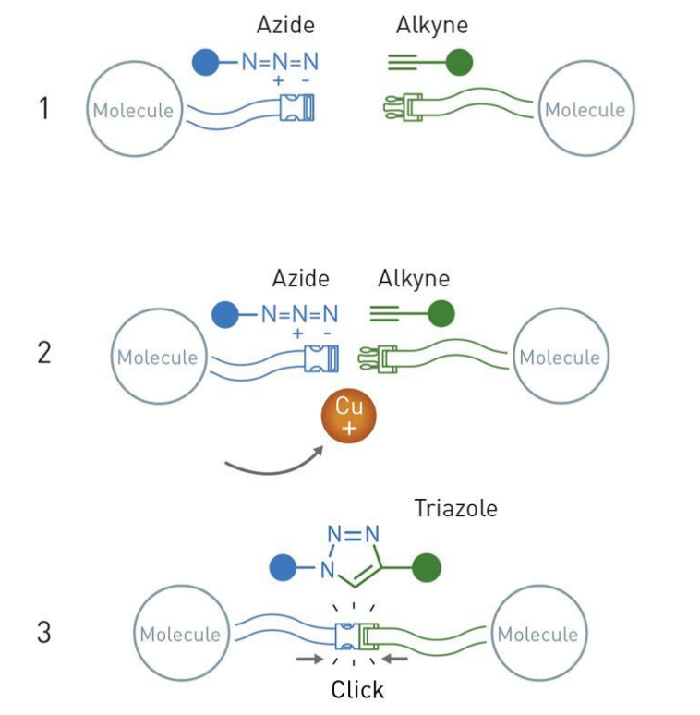
Click Chemistry
Convenient way of doing chemistry
Simple & no waste
Crown jewel of click chemistry: the copper catalyzed azide-alkyne cycloaddition
Widely utilized and reliable way of forming connections between different functional groups

Slide 6
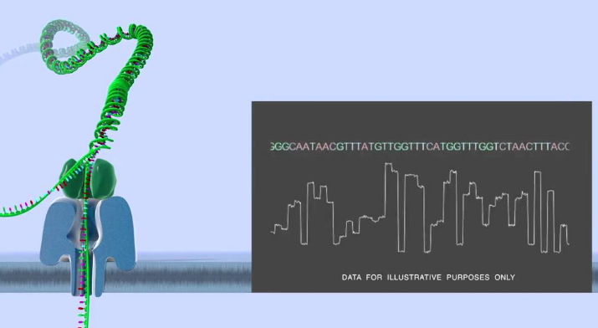
Nanopore
Literally a nano sized pore on a membrane
The pore and membrane can be biological, solid-state, or a hybrid complex of biological and solid-state
Principles
Apply a voltage across the membrane
Induced ion current is measured
Analyte passing through the pore causes current blockade (translocation event) and exhibits a unique signature
Analyte concentration correlate to frequency of translocation events
Challenges
Statistical in nature, requires at least nanomolar level of analyte concentration to operate practically
Direct application in complex clinical samples with interferent molecules

Slide 7
Paper

Slide 8
Motivations
Lower transmission rates for HIV and improve patient outcomes by extending detection window and monitoring capacity of HIV biomarker assays
Achieved through a lower limit of detection (LOD) and accurate quantification
Existing assays for HIV have either unsatisfactory sensitivity or has not made successful translation through clinical studies
PCR techniques for detecting circulating RNA is costly, time consuming, and does not have significant correlation with host immune parameters, such as infection-fighting CD4 cells, like p24 antigen does
This paper presents a nanopore assay amplified by click chemistry for detection of HIV-1 p24 antigen in clinical samples

Slide 9
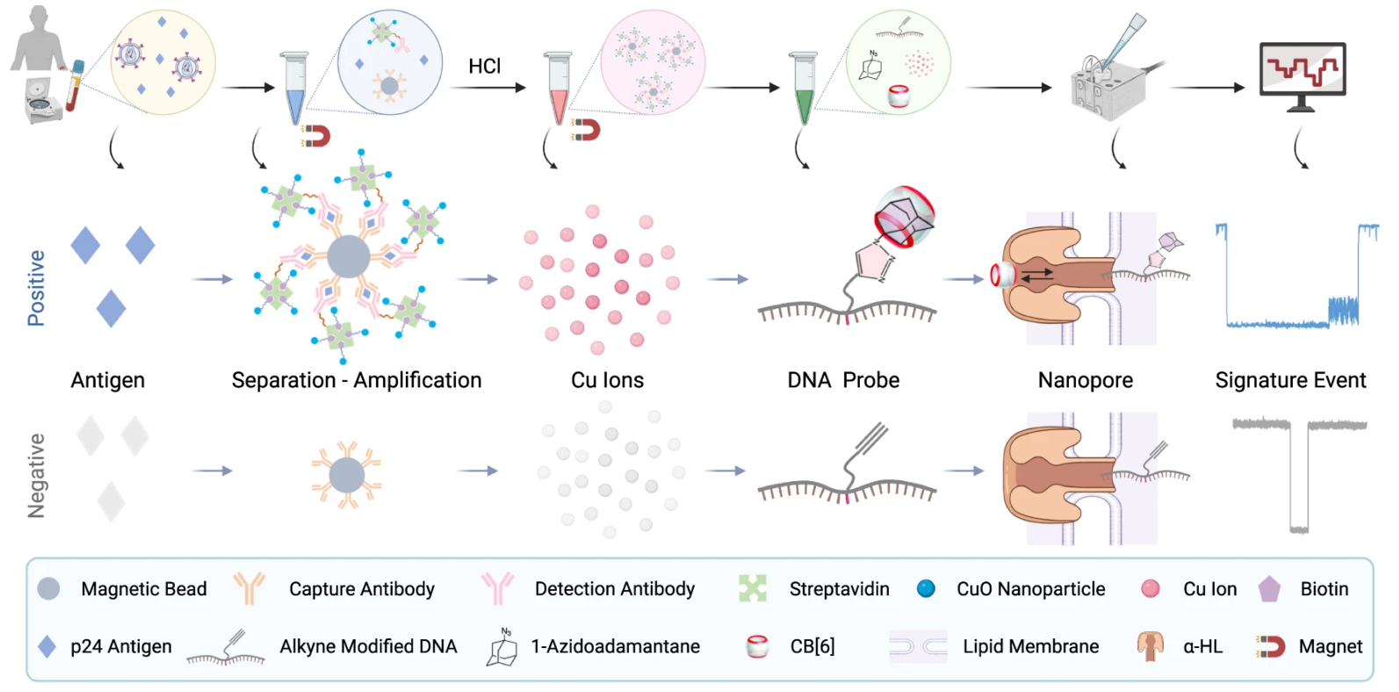
Click Chemistry Amplified Nanopore (CAN) Assay Workflow

Slide 10
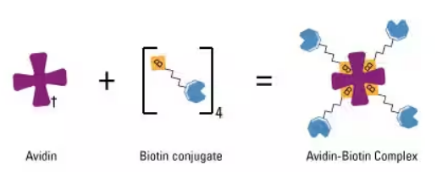
CAN Assay Overview
LOD of 20.8 fM (0.5 pg/mL) for p24 detection in human serum
40~100-fold higher analytical sensitivity than a fluorescent copper nanoclusters (CuNCs) assay
20-fold higher analytical sensitivity than a clinically used benchmark ELISA
Selectivity due to multi-level translocation signal that is clearly different from translocation signatures of other molecules
High sensitivity due to amplification by click chemistry & biotin-avidin binding

Slide 11
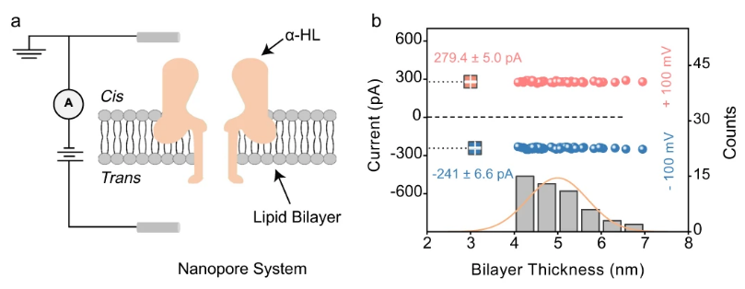
Nanopore Characterization
Ensure proper operations of the nanopore
Notes:
To ensure that the nanopore will operate properly, positive and negative voltages were applied to the trans side of open channel nanopore with cis side grounded.
A properly inserted α-HL pore is characterized by larger ionic current under a positive trans voltage than it is under a negative trans voltage. This is indeed observed in figure b.
Also, the suitable thickness of a bilayer membrane for insertion is ~5 nm, corresponding to 160-180 pF capacitance. Measurements show that thickness distribution roughly centers around 5nm.
Nanopore characterization shows the nanopore system is properly setup.

Slide 12
Translocation Behaviors of DNA Probes
Characterizing multiple phases of the DNA probe
alkyne modified DNA
Sequence: 5’-CCCCCCCCCCT*CCCCCCCCCC-3’, T* indicates alkyne-modified thymine
DNA-1-Azidoadamantane (DNA-AA)
Obtained via click reaction between alkyne modified DNA & 1-Azidoadamantane (AA) in presence of copper ion catalyst
DNA-AA@cucurbit[6]uril hydrate (DNA-AA@CB[6])
Obtaiend via host-guest reaction between DNA-AA and CB[6]
Notes:
Difference phases of the DNA probes were also characterized to understand the raw current measurements from the nanopore system.
We have first the alkyne modified DNA, purchased from vendor.
Then, through click reaction between alkyne and azide, DNA-Azide (DNA-AA) was formed (this process takes >4 hours)
Finally, DNA-AA is incubated with CB[6] to form DNA-AA@CB[6] complex (also takes >4 hours)
Note that in the workflow of the assay, DNA-AA formation is dependent on the analyte concentration responsible for producing the copper ions for the click reaction. So, these time-consuming steps are part of the whole assay procedure.

Slide 13
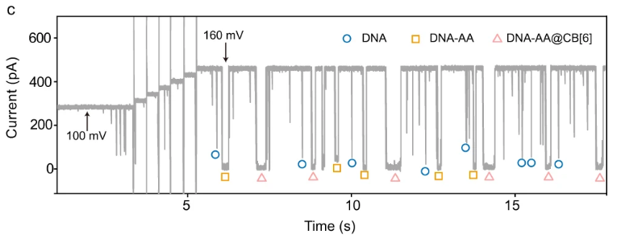
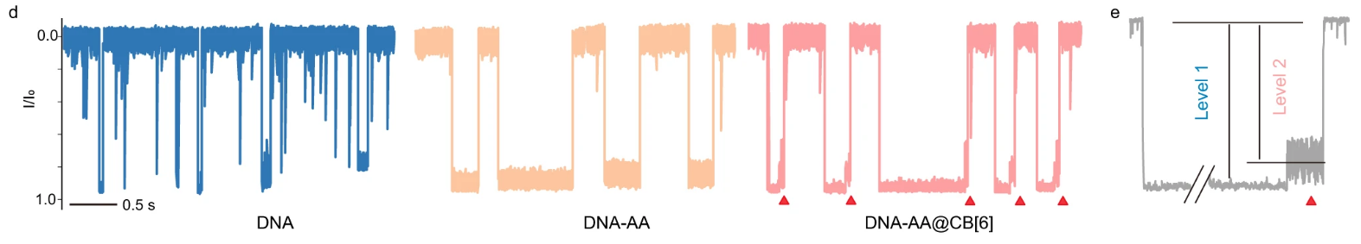
Translocation Behaviors of DNA Probes (Cont.)
Notes:
Figure c shows the raw current traces of the nanopore system. Different signatures of the DNA probes are marked.
Figure d shows the current traces for each phase of DNA probe in details. Each signature can be characterized by current magnitude and duration.
Difference in the characteristics between each phase of DNA probe is clearly seen.
For DNA-AA@CB[6] complex, there is a multi-level signature. This is seen more clearly in figure e. Level 1 signal is due to DNA backbone translocation, level 2 is due to CB[6] oscillation after dissociation. Multi-level signature ensures highly specific detection.

Slide 14
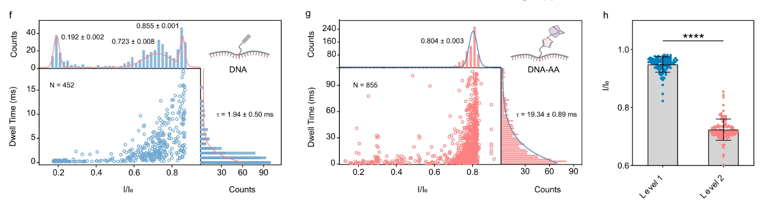
Quantitative Analysis of Translocation Events
Notes:
Quantitative analysis was done on translocation events for DNA and DNA-AA.
Graphs f and g are 2 dimensional graphs showing current blockage and dwell time profile. Dwell time is basically how long a molecule interacts with or blocks the nanopore.
You can see that in figure f for DNA, current blockade centers around 0.855. The other peaks, explained by the authors, may be due to background noise and random DNA collision with the nanopore.
Figure g for DNA-AA has similar blockage profile, but without non-specific peaks. However, mean dwell time for DNA-AA significantly increased.
DNA-AA@CB[6] complex did not further change the current blockade and dwell time profile, but this structure does cause a two-level translocation signal as discussed previously. This is quantified in figure h, where the authors performed a statistical test call unpaired two-samples t-test, which tests if the means of samples are the same. The test found that p < 0.0001, which suggests the difference in dwell time mean is likely not due to chance. In other words, there is statistical significance between the mean current blockade between level 1 and level 2 signals.

Slide 15
Capture Rate

Slide 16
Opinions

Slide 17
Opinions?
Graphs are properly labeled, easy to interpret, coloring is generally consistent
Detection mechanism diagram shows both positive and negative detection scenarios
The only novelty is in the copper ion delivery system where each captured analyte yield 4 copper ions instead of 1
Nothing said about significance of DNA sequence used or why the linking happens at middle position of sequence
Not sure how specificity is calculated in Fig 5.c
Would like to see a diagram of the nanopore assay
Unclear if assay uses single nanopore or a matrix of nanopores for detection
Important to reduce time and cost of assay

Slide 18
References

